Slide 1

Attention Based Video Recognition
Jose Principe
UNIVERSITY OF FLORIDA
principe@cnel.ufl.edu

Slide 2
Bottleneck in Deep Learning
Results have been promising, but computational complexity is a problem for large datasets and real world scenario
One solution is to take inspiration from the fixation and representation system of the Human Vision System (HVS)
Humans have a remarkable ability to process complex scenes and form representations rather quickly

Slide 3
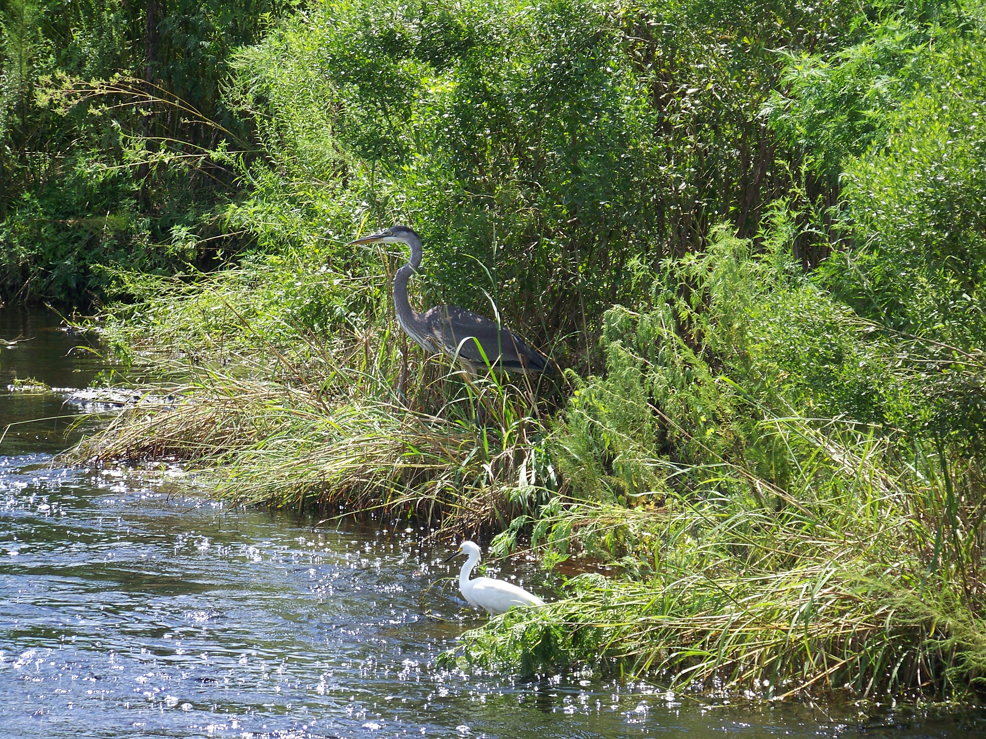
Perception is an active process based on context and predictions

Slide 4
Perception is an active process based on context and predictions

Slide 5
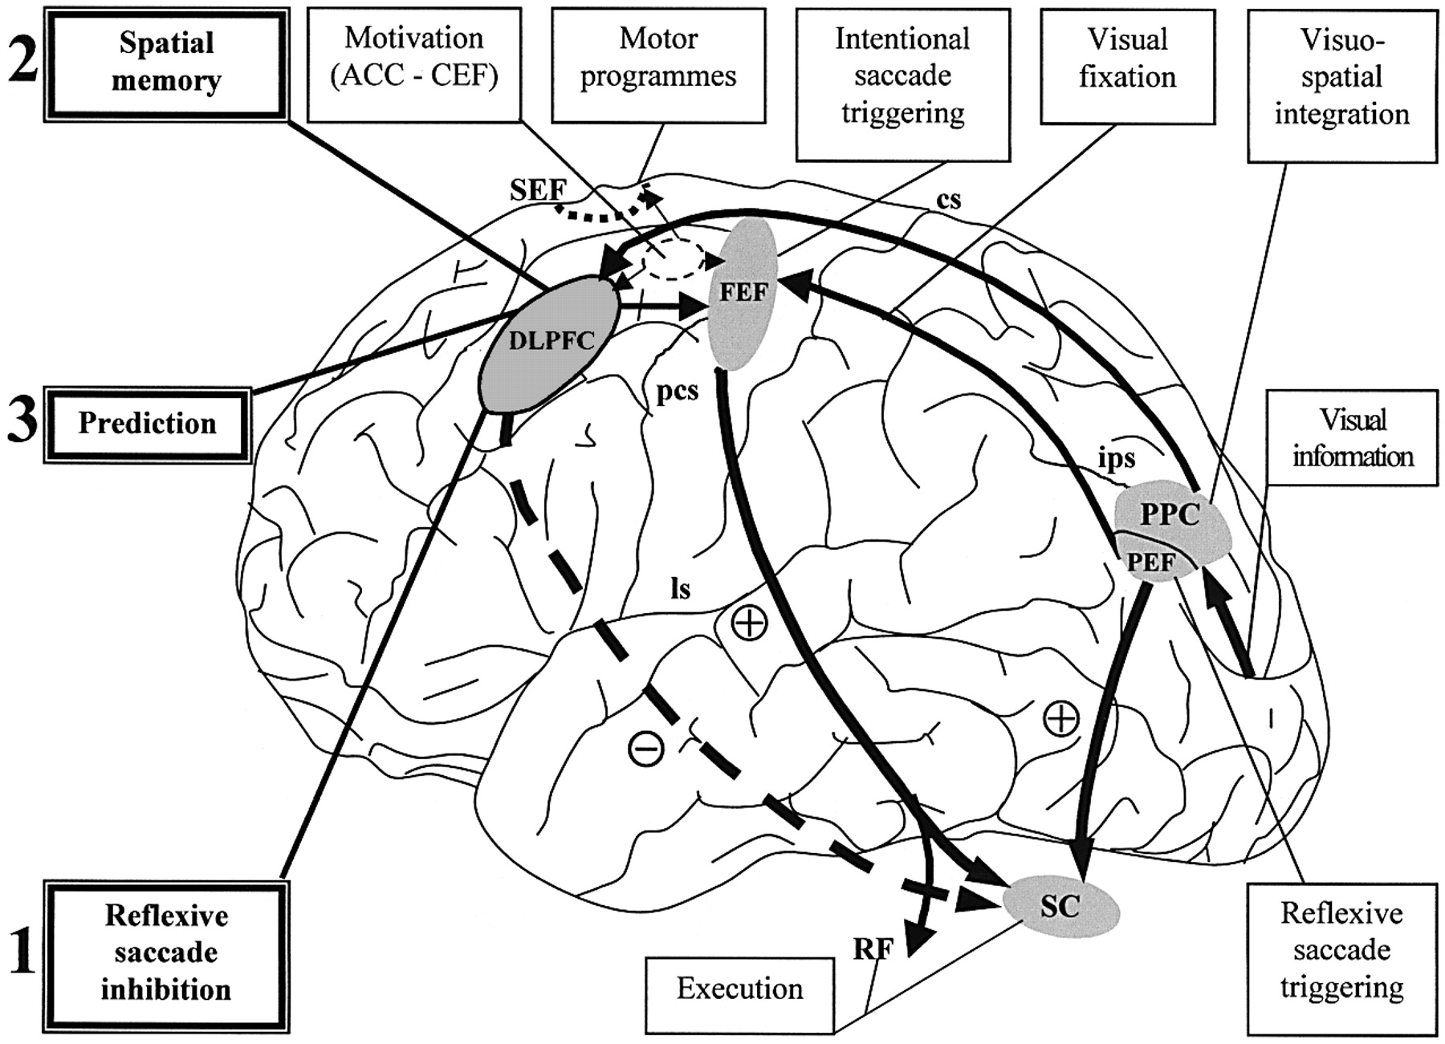
Human Visual System
Rather than processing an entire scene at once, the HVS fixates on small regions, forms representation of these regions, and combines them into an overall view

Slide 6
Human Inspired Scene Understanding (HISU)
Ventral Pathway
Unsupervised Object Identification
Works with fine visual details over small areas (foveal region)
Uses long term memory to store representations of objects
Dorsal Pathway
Object Location
Spatial perception and motion over large areas
Requires working memory to place objects in scenes
Hypothesis: A generative model of images for autonomous vision can be created by combining a fixation and saccade system (dorsal pathway) with an object recognition system such as a neural network (ventral pathway),

Slide 7
Human Inspired Scene Understanding (HISU)
What is the advantage of this functional decomposition in machine learning terms?
The joint distribution of the model parameters p_{θ}(I ) over the data I, where θ are the model parameters, is effectively being factorized in two marginals that are approximately independent.
Let I be composed of objects s ∼ p_{θ}(s) centered in the (x, y) coordinates in the larger image . These coordinates can be modeled as a r.v. δ_{xy} ∼ p_{θ}. For the finite dataset, p_{θ}(s) is also a categorical distribution conditioned on the true objects. For this finite case the generative model can be factored as
p_{θ}(I, s, δ) = p_{θ}(s) p_{θ}(δ_{xy} )p(I |s, δ_{xy} )

Slide 8
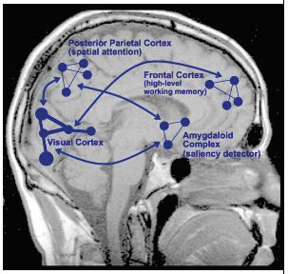
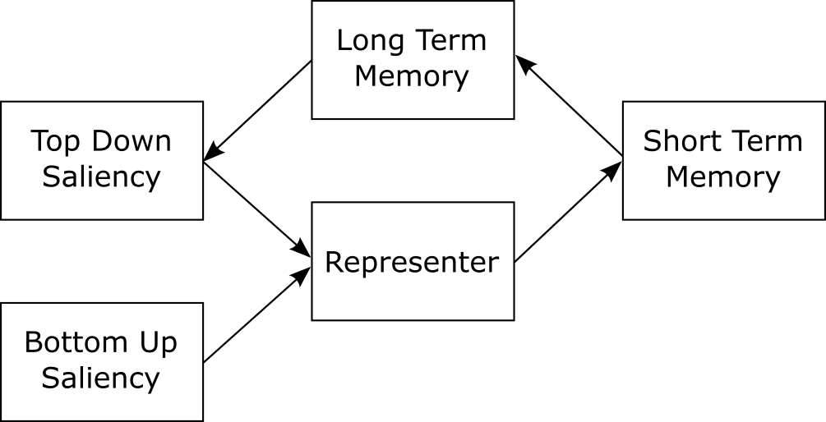
Minimal Vision Architecture
Human Inspired Scene Understanding (HISU)
Visual
Representation
DPCN

Slide 9
Human Inspired Scene Understanding (HISU)
Using this architecture as inspiration we can take any still image, fixate on small, interesting, quick-to-process regions, scan each, and create a video by rotating these frames
This video is then sent to the vision system (DPCN) for recognition
Using location information from the fixations and the representations from the DPCN, an overall structure of the image can be learned

Slide 10
HISU (Ventral)
Previous Architecture
New Architecture
Based on a dynamical system
Uses Empirical Bayes (free energy optimization).
Bidirectional architecture (top down causes)
Requires inference for testing
Very slow
Based on a neural net (convolutional and recurrent) architecture
Uses gradient descent learning
Top down is limited (only errors)
Testing is recall
Much faster and similar performance
More flexible

Slide 11
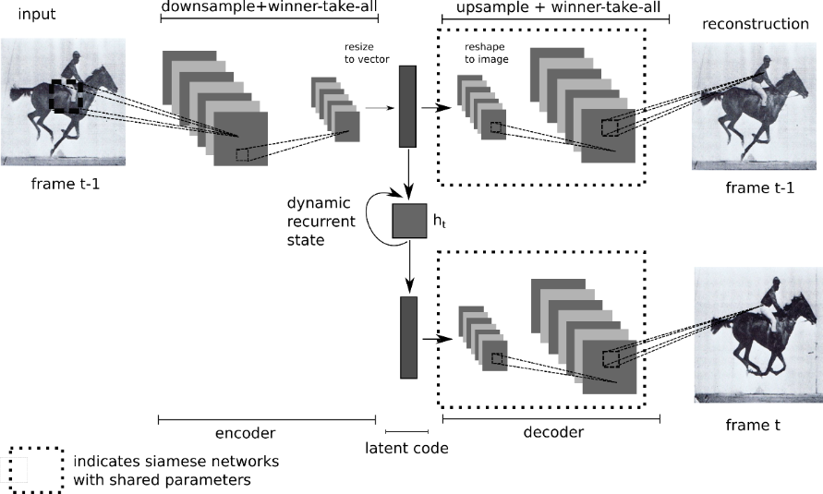
HISU (Ventral)
Deep Predictive Coding Networks (DPCN)
Unsupervised method of forming representations of visual data
Combines a spatial convolutional architecture with a temporal convolutional architecture

Slide 12
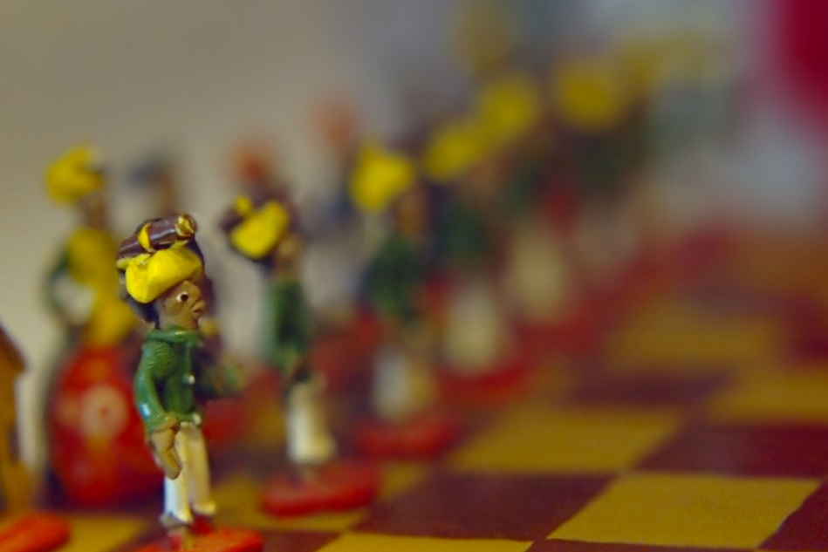
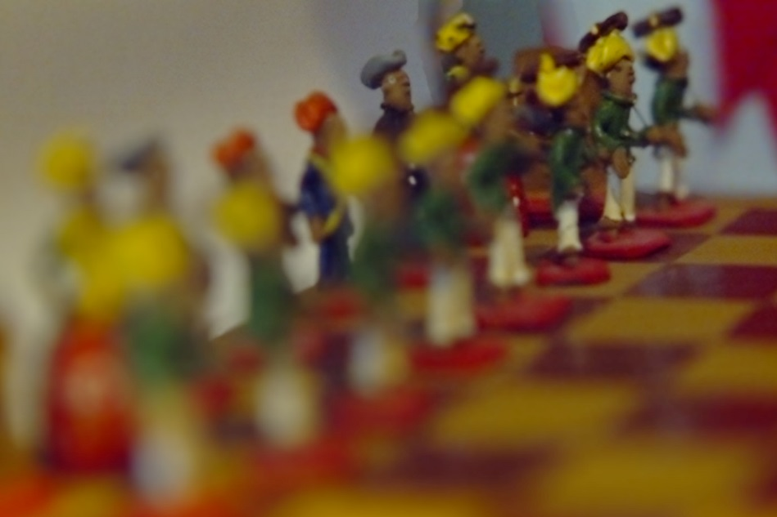
Light Field Cameras (Lytro)
The Lytro is a camera capable of capturing lightfields instead of standard digital pictures
The use of lightfields allows a picture to be refocused to different depth levels after the initial capture
This refocusing can be used to approximate the foveation and fixation in the HVS

Slide 13
Saliency
Saliency is defined as the quality by which an object stands out relative to its neighbors
It has been shown to correlate with eye-tracking data, which is used as a measure for attention
Due to this correlation, saliency is often used as a bottom-up attention-deployment algorithm
However, traditional saliency algorithms work with a full resolution image while the HVS has a high resolution fovea surrounded by a blurred periphery

Slide 14
Saliency in Foveate Images
Since saliency algorithms have not been tested in foveate images, our first task was to test saliency algorithms in a bio-inspired environment.
We blurred each image in the CAT2000 database around an initial center point
Seven popular saliency algorithms were tested with these new blurred images
Graph Based Visual Saliency (GBVS) and Torralba performed the best under these conditions
We selected GBVS due to a computation speed advantage and because of fewer false positives.

Slide 15
Saliency in Foveate Images
Most saliency measures work by breaking an image into feature matrices (M), computing local differences with sparseness.
GBVS works by initially forming a dissimilarity measure to form the weights of connected graph
A Markov chain is defined on the graph forming an activation measure derived from pairwise contrast between pixels
Concentrates mass on each activation map (A) by forming another graph and defining a new Markov chain
It then fuses the maps by normalizing and adding them

Slide 16
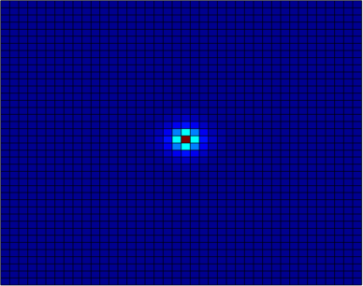
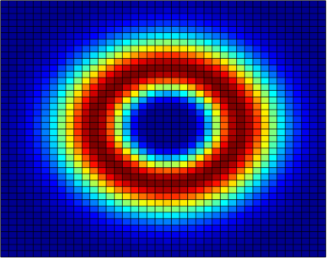
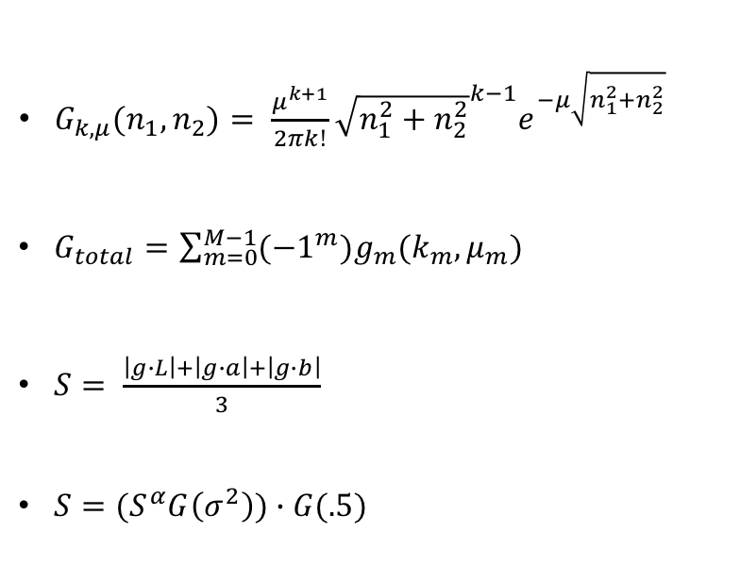
Dorsal Path- Gamma Saliency
$G_{k,μ}(n_{1},n_{2})= \frac{μ^{k+1}}{2πk!}{\sqrt{n_{1}^{2}+n_{2}^{2}}}^{k−1}e^{−μ\sqrt{n_{1}^{2}+n_{2}^{2}}}$
$G_{total}=\sum_{m=0}^{M−1}{({−1}^{m})g_{m}(k_{m},μ_{m})}$
$S= \frac{\left|g∙L\right|+\left|g∙a\right|+\left|g∙b\right|}{3}$
$S=(S^{α}G\left(σ^{2}\right))∙G(.5)$
Each image is broken into 3 Lab color channels
Local differences are computed by convolving each channel by the combined gamma kernel
Instead of breaking the image into different scales, kernels of different scales are summed before the convolution
Peaks are accentuated by raising each map to an exponent > 1
Each map is summed into a total saliency map, center weighted, and blurred
Center kernel Surround kernel
R. Burt, E. Santana, J. Principe, N. Thigpen, A. Keil, “Predicting Visual Attention using Gamma Kernels,” ICASSP 2016

Slide 17
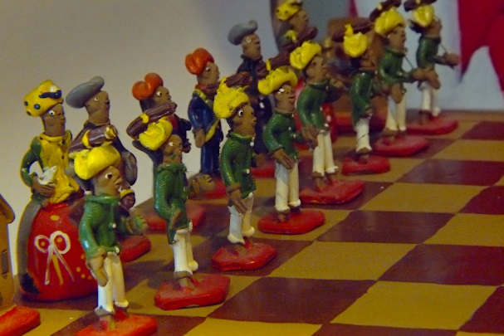
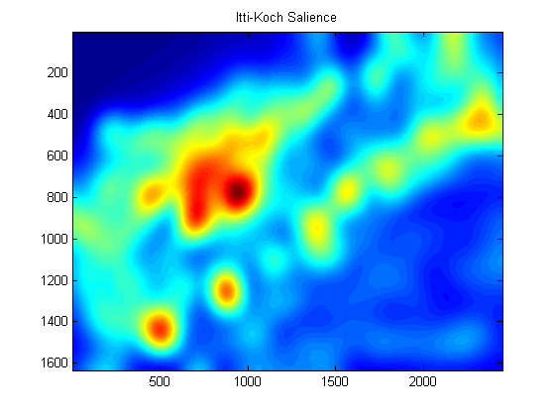
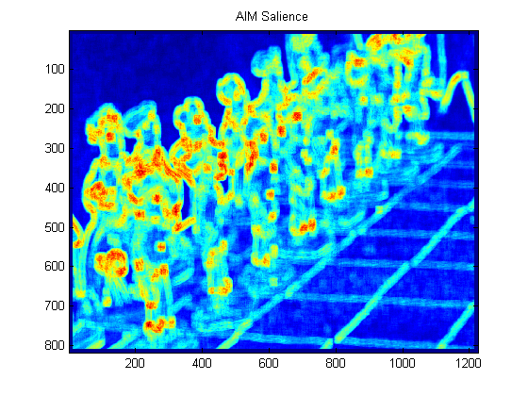
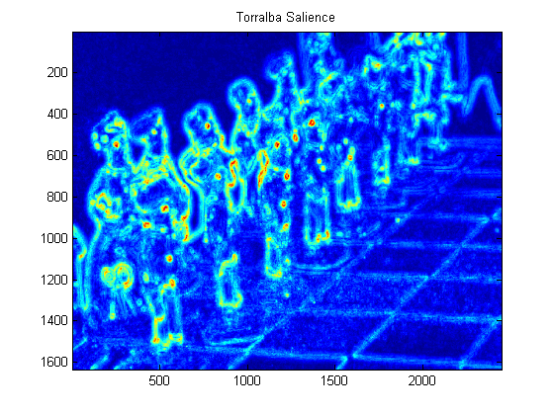
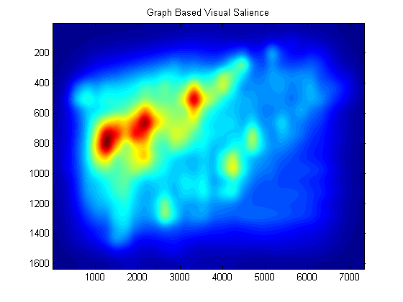
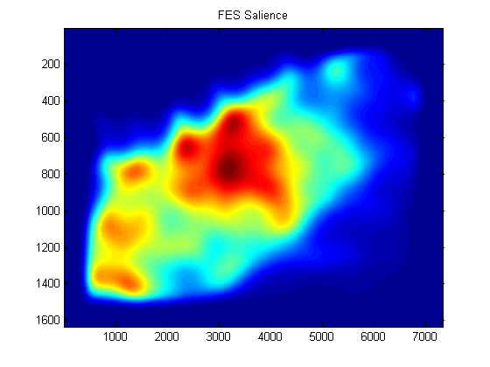
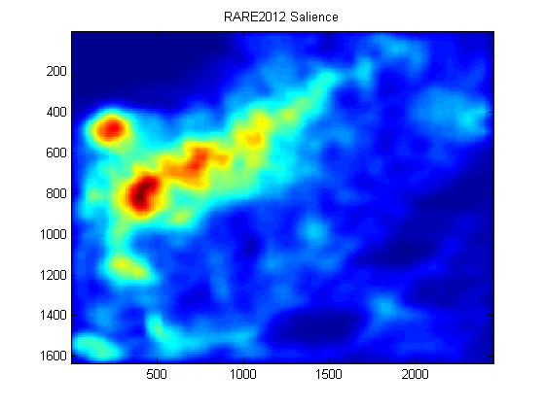
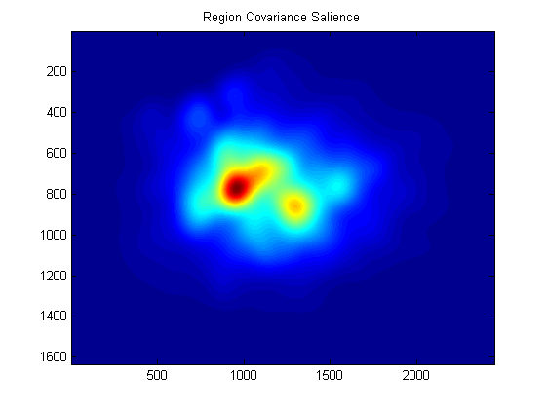
Saliency Map Examples

Slide 18
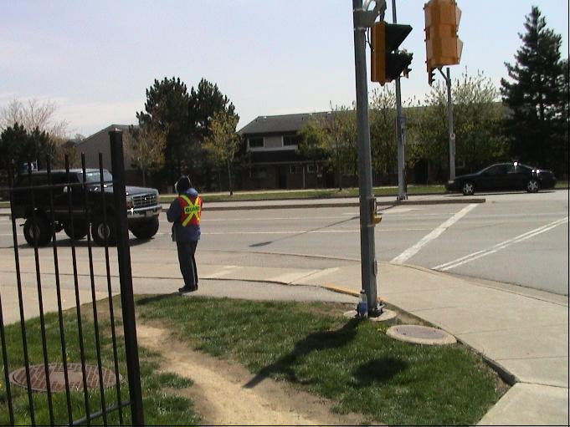
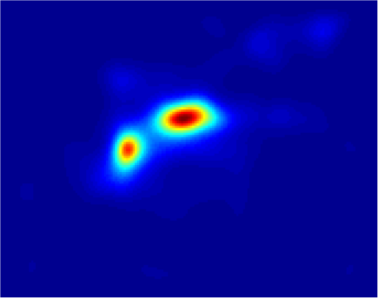
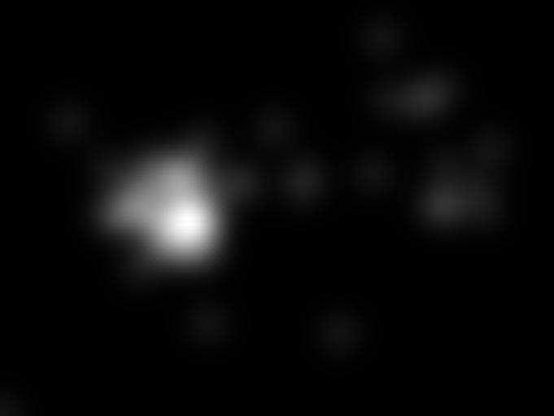
Gamma Saliency
Original Image
Gamma Saliency
Fixation Map

Slide 19
Saliency in Foveated Images
Saliency Test Results on Foveated Toronto Database
To test saliency algorithms in a bio-inspired environment we foveated each image in the Toronto database around an initial center point
Gamma Saliency tested against 7 other common saliency algorithms
Best results in 4 out of 5 metrics and the fastest to compute
Foveation worsened results
Method \ Metric | ROC (Judd) | ROC (Borji) | Similarity | Correlation | NSS | Time (sec)
Itti | .737 | .597 | .403 | .314 | .369 | .280
AIM | .794 | .657 | .433 | .458 | .561 | 1.10
Torralba | .784 | .650 | .433 | .469 | .539 | .78
GBVS | .839 | .664 | .502 | .603 | .594 | 1.03
FES | .846 | .571 | .487 | .536 | .403 | .21
RARE2012 | .841 | .656 | .525 | .632 | .591 | 1.39
RCS | .829 | .629 | .517 | .595 | .517 | 15.84
Gamma | .858 | .684 | .607 | .649 | .483 | .21

Slide 20
Human Inspired Scene Understanding
Focus on image center
To approximate the saccade and fixation system in the HVS, we used the refocus ability of the Lytro with a nested saliency approach to correctly locate objects
The next fixation region is predicted using GBVS, the picture refocused around that point, then local saliency is computed for precise location
This region becomes the new focal point and is broken into frames for the DPCN
Compute Saliency
Refocus Image
Compute Saliency in local region
Collect frames by scanning salient area
Inhibit return in future saliency maps

Slide 21
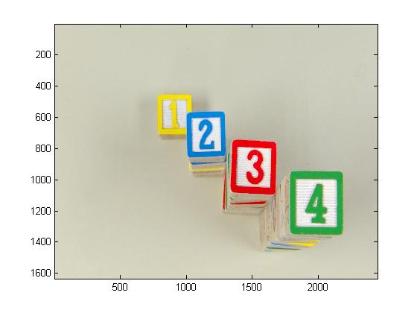
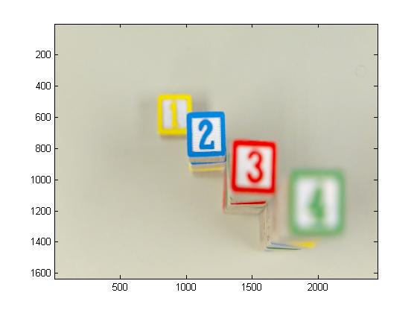
Human Inspired Scene Understanding
FOA Algorithm
Original Image
Center-focused Image

Slide 22
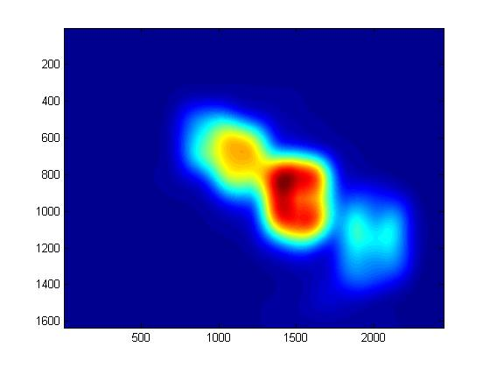
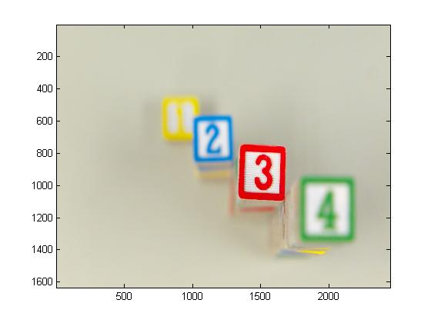
FOA Algorithm
Human Inspired Scene Understanding
Saliency map from center focus
Refocused around most salient point

Slide 23
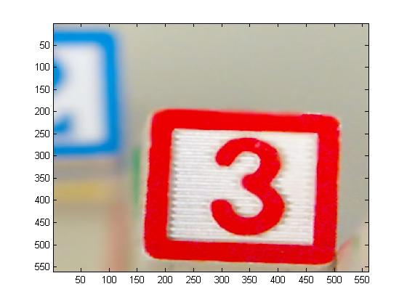
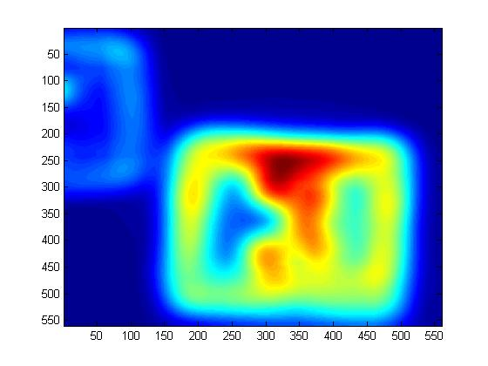
Human Inspired Scene Understanding
FOA Algorithm
Sampled patch
Local saliency

Slide 24
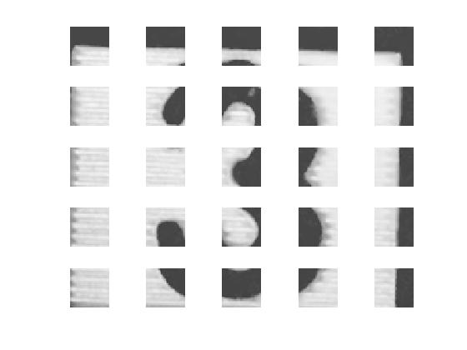

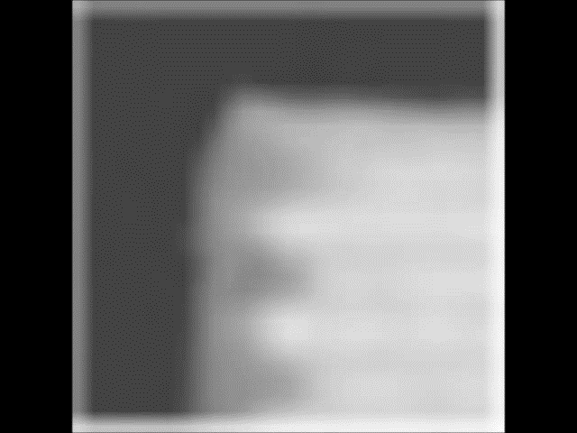
Human Inspired Scene Understanding
FOA Algorithm
Scanned frames
Segmented object

Slide 25
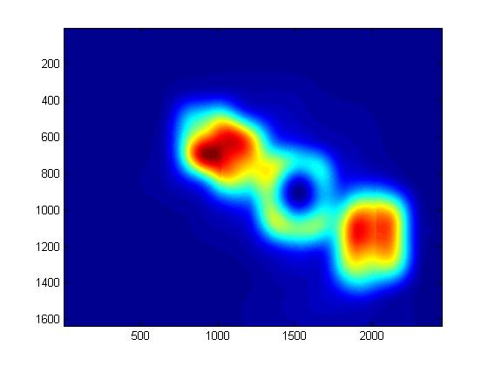
Human Inspired Scene Understanding
FOA Algorithm
Saliency with return inhibition
Refocus around new salient point

Slide 26
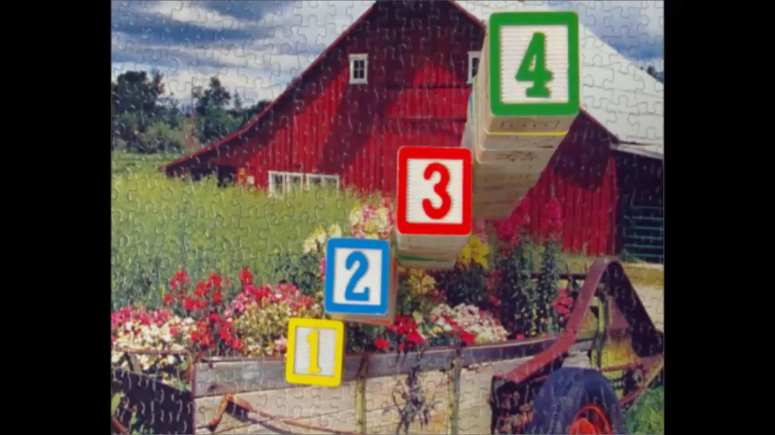
HISU Example
This video shows a comparison between eye-tracking data and the saliency based focus of attention
The left frames show fixations from eye-tracking data
The right frames show the Lytro image jumping to salient regions (green square), refocusing the picture, and finally centering around the object (blue square)

Slide 27
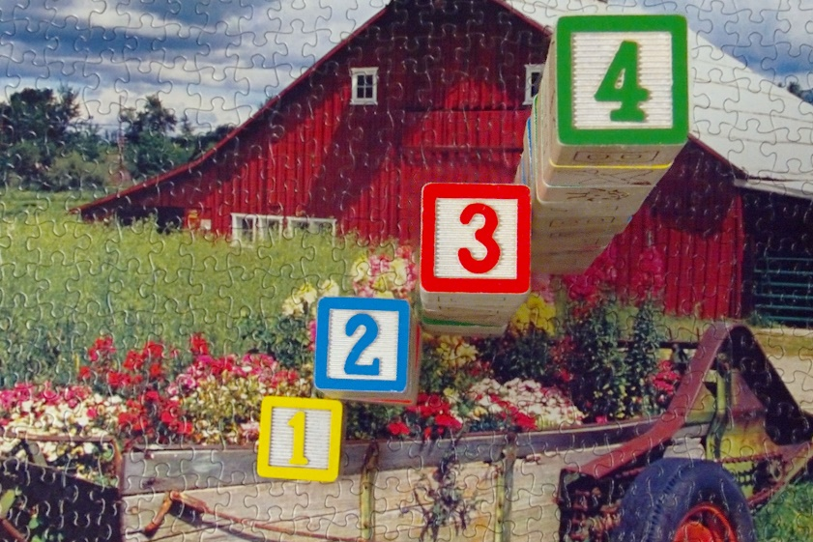
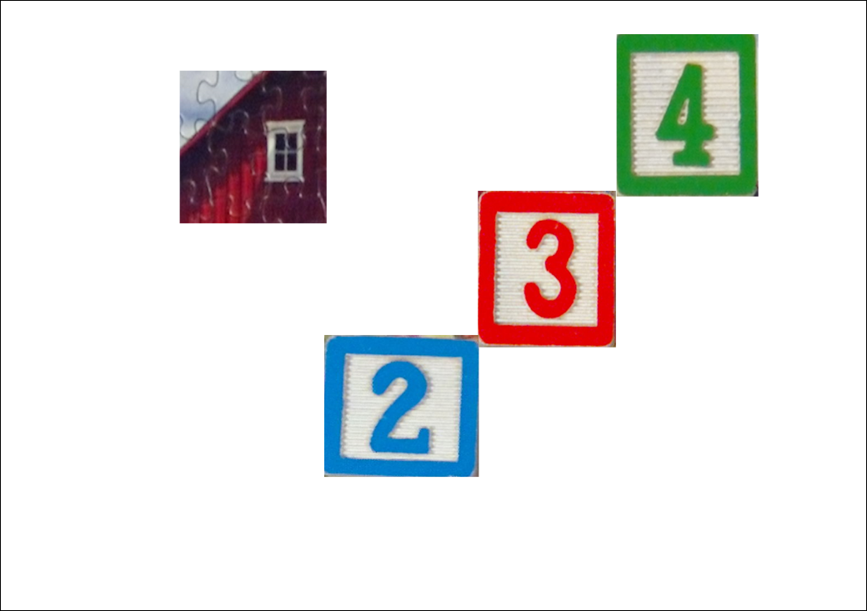
HISU Example
Scene Working Memory
Places representation of objects at their locations in the current scene
Used to formulate spatial relationships between objects

Slide 28
Computation Comparison CPU/GPU
 | CPU | GPU
time to compile | 14.9s | 33.64s
time to process 108 samples from Lytro blocks dataset | 7.07s | 2.74s
Algorithm developed in Python/Theano
CPU is an Intel core i9-4000. GPU is a Nvidia Tesla K20c
GPU networks take a little longer to compile. But this time completely pays off in processing time.
We experimented with two layers fully connected DPCNs with 100 hidden neurons.
The speed up scales up with larger networks

Slide 29
Computation Pixel versus Convolution
 | Pixel | Convolutional
time to process 3064 videos | 22 sec | 161 sec
We compared the time that it takes for a single layer DPCN to process 30 batches of videos ( 3064 videos) to evaluate the speed differences between pixel based fully connected and convolutional architectures.
Using as few a 9 filters of size 5x5 for the convolutional neural network is almost 10x slower than a 100 state fully connected network.
Still need to test generalization of each.

Slide 30

Computation Complexity with DPCN-FOA
To show the improvement in computation speed, we created a database of 108 images consisting of number blocks against a blank background
The first test involved the DPCN scanning the entire 644x644 image (529 frames)
The second used the FOA mechanism to extract a 140x140 patch for processing (25 frames)

Slide 31
Computation Complexity with DPCN-FOA
Each set of 108 videos was trained for 100 batches on the DPCN
Despite small overhead incurred by the FOA, the overall running time was smaller (5.4% of the full images).
Number of patches multiply computation time
Performance is better
Computation Times (seconds)
 | FOA | DPCN | Total
Full Images | 0 | 5741 | 5741
Sampled Patches | 43 | 269 | 312
Sampled Patches | Full Images
98% | 42%

Slide 32
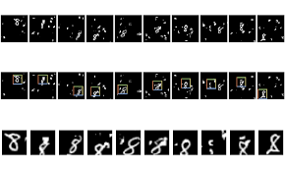
Results in Cluttered MNIST
Built from original 28x28 MNIST images with handwritten digits
Digits are randomly sized and rotated, then placed into a blank 60x60 background with randomly placed correlated cluttered
Clutter is generated through taking random 6x6 crops of other digits and placing them in the background

Slide 33
Results in Cluttered MNIST
Since the images are small and contain similar targets, a single scale gamma kernel was used for saliency
Center kernel: order 1, shape parameter .2
Surround kernel: order 9, shape parameter .5
Results were computed with the full 60x60, a 40x40 patch centered around the most salient point (mid), a 28x28 patch (small).
The spatial transformer network (STN) uses a localization network based on labels
Incorporation of focus of attention improves CNN also
Note that the CNN and STN are supervised methods
Metric\Method | DPCN Full | DPCN Mid (FOA) | DPCN Small (FOA) | CNN Full | CNN Mid (FOA) | CNN Small (FOA) | STN¹
Classification (%) | 62.58 | 84.34 | 88.59 | 88.00 | 91.75 | 92.76 | 95.69
Time (s) | 5214 | 2460 | 1600 | 38 | 28 | 23 | 49
1: Jaderberg, Max, Karen Simonyan, and Andrew Zisserman. "Spatial transformer networks." Advances in Neural Information Processing Systems. 2015.

Slide 34
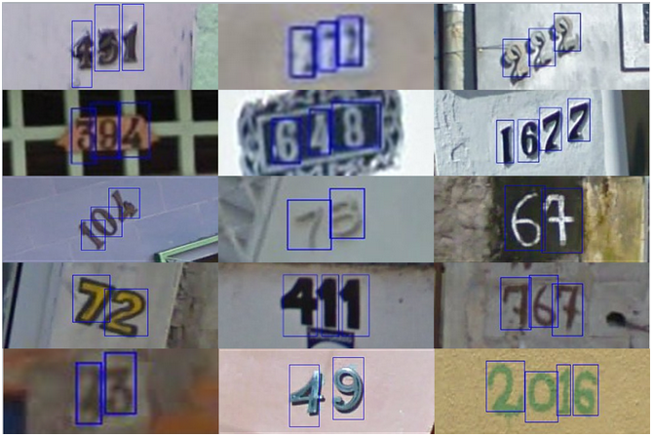
Google Street View House Numbers
Over 600,000 digits as house numbers on real backgrounds
Different number of digits of variable size
Color, style and background varies greatly
Best result is achieved with the Spatial Transform Network on bounding boxes (supervised)

Slide 35
Google Street View House Numbers
Our approach is totally unsupervised
Using Gamma Saliency, we gather up to 5 patches from each image
The extent of the patch and segmentation are computed automatically, from the multiscale kernel
DPCN is trained on each patch using rotations (video)
Gamma Saliency creates automatically bounding boxes

Slide 36
Google Street View House Numbers
Results on the Bounded Dataset
 | Unsupervised |  |  |  | Supervised
Method \ Metric | DPCN w/ Attention | TDN w/ Attention | Auto-encoder | VAE | CNN Full | CNN w/ Attention | STN Full
Classification | 92.51 | 92.28 | 15.58 | 17.46 | 94.47 | 96.06 | 96.30
Segmentation | 83.67 | 83.67 | 76.92 | 76.92 | 76.92 | 83.67 | NA
Time (s) | 12638 | 2015 | 2372 | 2784 | 1426 | 1195 | NA
Results on the Full Dataset
 | Unsupervised |  |  |  | Supervised
Method \ Metric | DPCN w/ Attention | TDN w/ Attention | Auto-encoder | VAE | CNN Full | CNN w/ Attention | STN Full
Classification | 73.30 | 71.59 | 5.13 | 8.34 | 68.15 | 80.58 | 28.03
Segmentation | 72.43 | 72.43 | NA | NA | NA | 72.43 | NA
Time (s) | 22658 | 2943 | 3689 | 4016 | 2397 | 1506 | 4559
Our DPCN with attention (unsupervised method) is better than CNN (supervised) when digits are not cropped

Slide 37
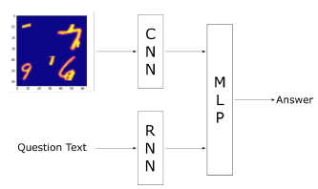
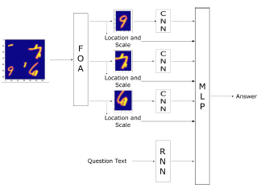
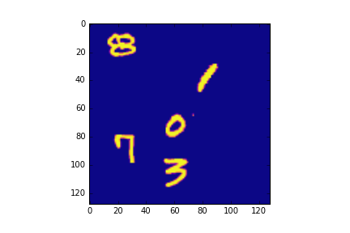
MNISTVQA
Combined CNN to extract visual features with RNN that could answer questions
Is a 3 present in the image?
What is the sum on the digits?
Method | % Questions Correct
Baseline | 69.3
FOA | 75.3
R. Burt, M. Cudic, J. Principe, “Fusing Attention with Visual Question Answering,” IJCNN, pp.949-953, May 2017

Slide 38
Top Down Saliency
In order to avoid outliers need to quantify context
Goal-driven approach
Feature learning
Specific colors, sizes, orientations
Dimensional weighting
Weight entire dimension (Color, size)
Associative learning
Store saccadic patches for future use, i.e. other objects, current search conditions, background characteristics

Slide 39
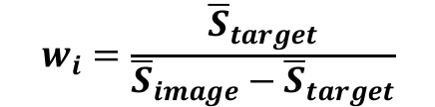
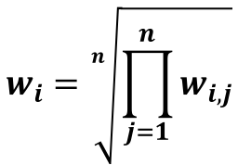
Top Down Saliency
Learns weights for each feature in saliency metric
Takes classified objects from training data and learns weights to maximize the saliency of these objects
Given the target region, weights for each feature are computed by the ratio of the mean saliency in the target region to the mean saliency of the background
Final weights are the geometric mean across all images

Slide 40
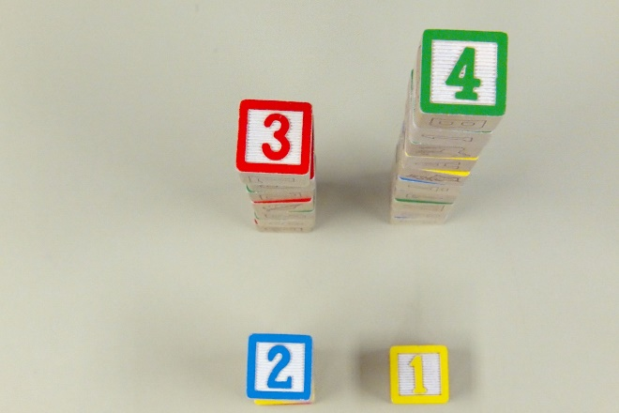
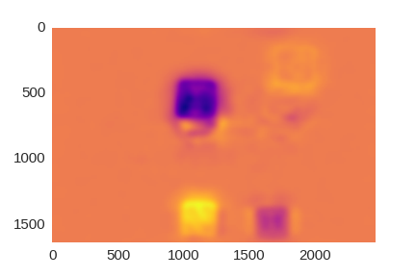
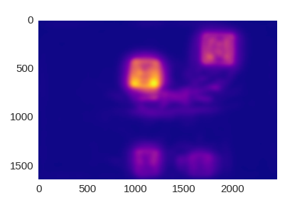
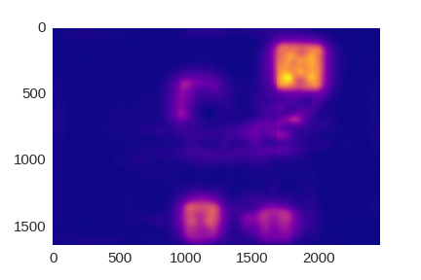
Top Down Saliency
Top-Down saliency goal: find numbers in ascending order
Bottom-Up saliency approach – no goals
Top-Down
Initial Saccade
Bottom-Up

Slide 41

Top Down Saliency
Top Down Saliency Example
Video shows the differences between top-down and bottom-up saliency
The top down saliency was trained to find the numbers in order (1 then 2, etc.)

Slide 42
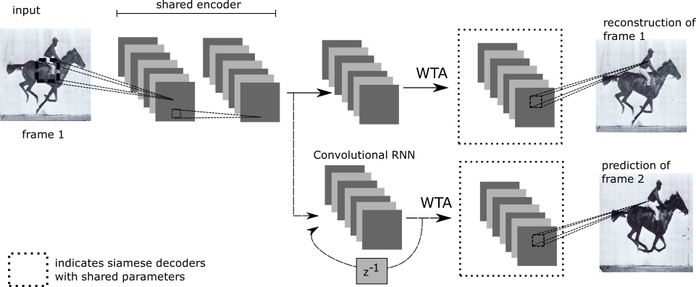
Feature Maps
Top Down Attention with Feature Maps
There is no reason to use saliency in the input space!
The DPCN is a convolutional spatio-temporal network that learns to represent objects
By taking the output of the shared encoder, we have a set of convolutional feature maps
These maps encode learned features that the network uses to separate the objects
These maps can be used as an alternate input to the saliency measure

Slide 43
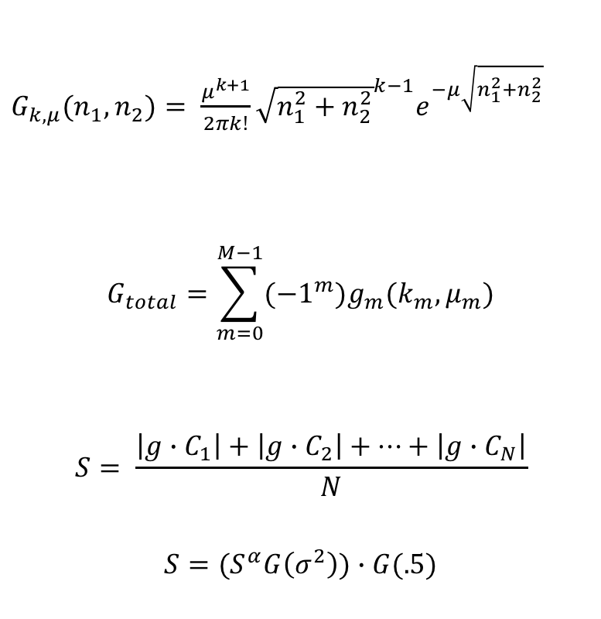
Top Down Attention with Feature Maps
Instead of only using color channels as feature maps, we can now use the convolutional feature maps from the RWTA
The rest of the Gamma Saliency algorithm remains the same
Feature maps convolved with the multi-scale difference kernel
Average of the convolution outputs computed
Post-processing (blurring, peak accentuation, center weighting)
R. Burt, J. Principe, “Top-down Gamma Saliency - Learning to Search for Objects in Complex Scenes,” IJCNN 2018

Slide 44
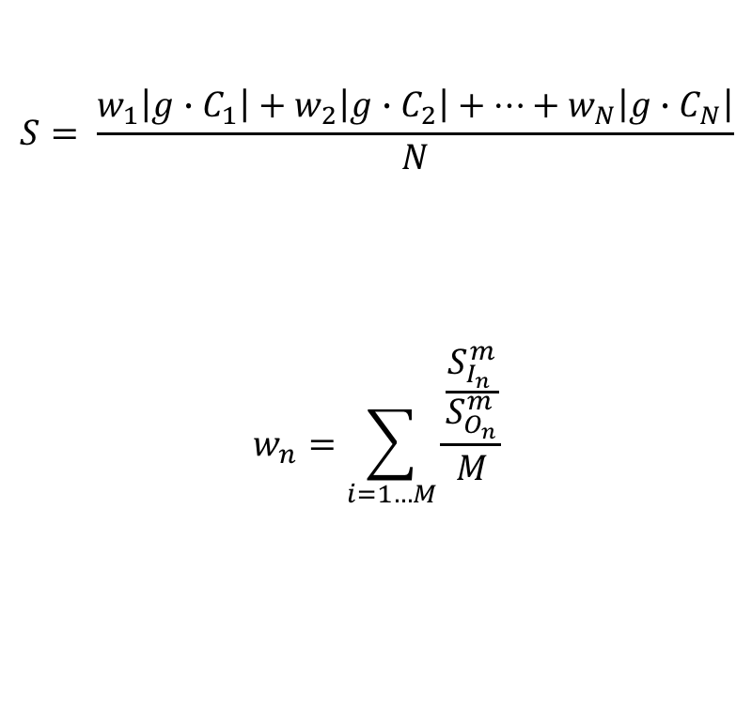
Top Down Attention with Feature Maps
To search for a specific object, we can learn a set of weights that correspond to the feature maps
The remembered weights for each object are the mean ratio between the saliency within the bounding box of the object and the saliency outside
These weights are applied as a prior to the bottom up saliency to locate the object in a new scene
m specific image, n specific object
R. Burt, J. Principe, “Top-down Gamma Saliency - Learning to Search for Objects in Complex Scenes,” IJCNN 2018

Slide 45
Internal Attention – Example
Top Down Attention with Feature Maps
We created a dataset consisting of 10000 128x128 images each with 5 MNIST digits placed in the scene
The goal is to recognize each digit with the fewest possible saccades
Method I: bottom-up saliency
Method II: internal attention
Example Image

Slide 46
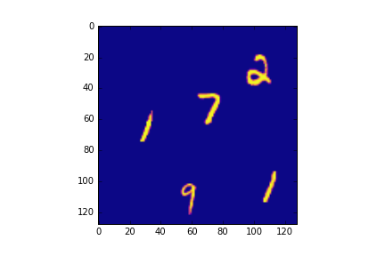
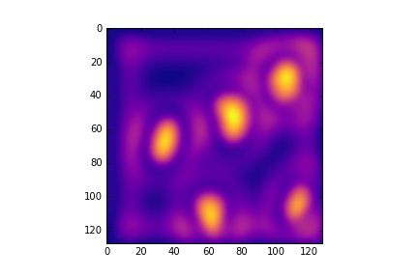
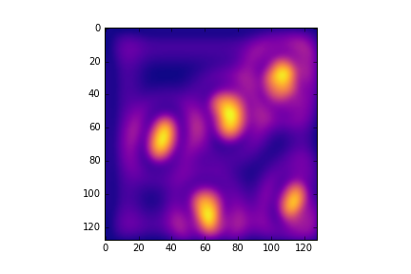
Internal Attention – Results
Top Down Attention with Feature Maps
For the bottom-up saliency model, it took an average of 3 saccades to find and identify each number
For the top-down model, each number was found and identified in 2.2 saccades on average
Improvement despite using a simple linear model!
Original
Bottom-Up
Top-Down

Slide 47

Top Down Attention – Noisy MNIST Results
Classify whether the target digit is present
Input | Full Network | Bottom-up | Top-Down
Full Image | 72.3 | N/A | N/A
One Saccade | N/A | 61.4 | 84.1
Two Saccades | N/A | 68.3 | 92.3
R. Burt, J. Principe, “Top-down Gamma Saliency - Learning to Search for Objects in Complex Scenes,” IJCNN 2018

Slide 48

Top Down Attention – Search Results
80 images
20 images with snakes
20 images with birds
20 images with no snakes
20 images with no birds
2 tests
Find targets
Match human eye-tracking
Each trial consisted of a fixation cross, followed by a target cue,
and ending with a nature scene. Target cues indicated whether a
participant should search for either a bird or a snake in the subsequent
picture.

Slide 49


Top Down Attention – Search Results
Human eye Tracking
mean time to find target = 6.5 seconds (sd = 3.8 seconds)
correct responses = 70.5% (sd = 9.8%)
30 subjects

Slide 50

Top Down Attention – Search Results
Because of the small number of images we employed transfer learning.
we use the VGG16 network which is a 16 layer network with 13 convolutional layers and
three fully-connected layers trained on Imagenet.
The output of the final convolutional layer (before the subsequent max-pooling) is used to
generate the inputs to the top-down saliency. This produces 512 feature maps
Bottom Up Saliency
Bottom Up + Top down
Saliency

Slide 51

Top Down Attention – Search Results
Used only images with objects
Bottom-up takes an average of 39.8 saccades
Top-down takes an average of 5.9 saccades
 | ROC (Judd) | ROC (Borji) | Similarity | Correlation | NSS
Bottom-up | .586 | .427 | .362 | .267 | .398
Top-down | .792 | .615 | .562 | .331 | .461

Slide 52
CONCLUSIONS
The combination of a generative model for object recognition (unsupervised) with a saccadic system creates the essence of an autonomous vision system for image understanding
Performance rivals the best supervised deep learning methods.
Internal attention is better than bottom-up saliency
Still lots of optimization work!

Slide 53
FUTURE WORK
Online training for internal attention
Find an image patch with bottom-up saliency and trained DPCN, online update memory that stores top-down saliency weights instead of batch training
Move beyond simple linear weight models
Test on larger dataset with natural images with noisy backgrounds
Consider using a fully-convolutional network for the saliency model
Consider merging the saliency and DPCN

Slide 54

FUTURE WORK
Valence and Arousal for Goals:
From Internal to Top Down Attention
Valence is positive or negative associated with stimuli
Arousal is the strength of the reaction
Together, they can be used as a model to predict reactions to stimuli
We will create a representation for objects and situations in a
similar 2D space to trigger at least the following goals
Free exploration, Object analysis, Object search

